Slide 1
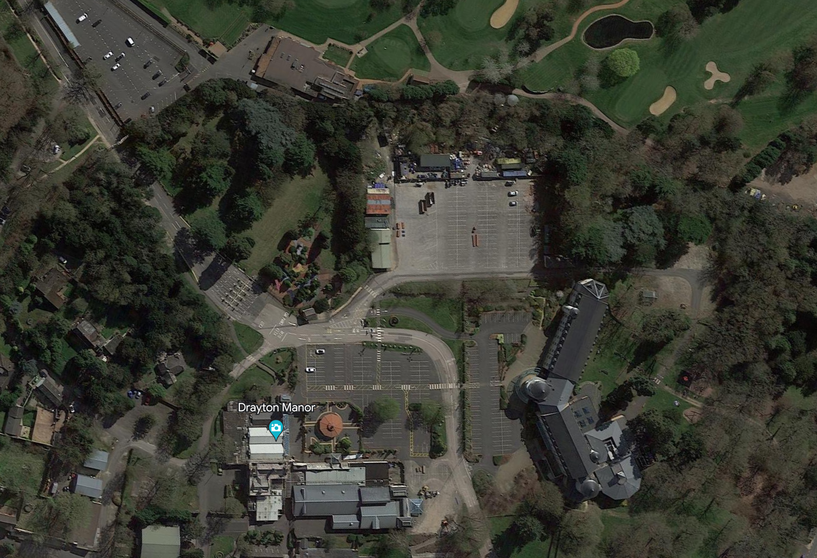
Car Parking
AHH / BHS Conference 2023
Drayton Manor
Entrance barriers
Hotel Car Parking
Hotel
Tower Suite – Conference location

